Slide 1
Bitcoin – mining [fundamentals + hardware]

Slide 2
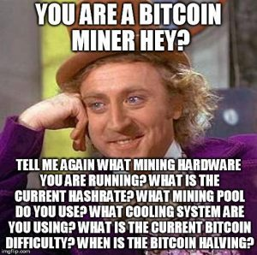
Mining
store and broadcast blockchain
validate new transactions
vote on consensus (using hash power)
incentives
who are the miners?
pros and cons of mining?
business model?
politics?
attacks?
1

Slide 3
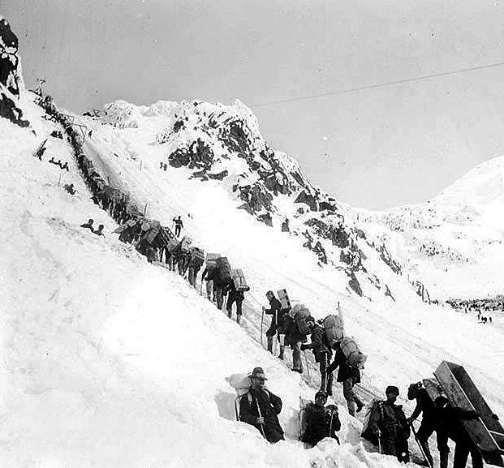
mining
Gold miners ascending the Chilkoot pass
Klondike gold rush of 1898
2

Slide 4
Process – 6 steps
join the network, listen for transactions
validate all transactions
listen for new blocks, maintain blockchain
when new block is proposed, validate it
assemble a new valid block
find the nonce to make your block valid
hope everybody accepts your new block
party!
3
Notes:
Validate – check signatures are correct and inputs are unspent
2. Maintain blockchain – first collect historical blocks from other nodes – for each block, validate transactions and nonce
3. Group latest transactions you have to make a block
4.
5. Lots of luck involved – you have to hope other miners start mining on top of your block rather than some competitors block
6. Profit profit profit
-two steps – first is essential: validation and making blocks
Second, not directly essential to currency, but directly related to first step – to incentivize miners

Slide 5
Finding a new block
prev: H( )
prev: H( )
mrkl_root: H( )
mrkl_root: H( )
nonce: 0x0001...
nonce: 0xffff...
nonce: 0x0000...
nonce: 0x0001...
nonce: 0x0002...
nonce: 0xf77e...
nonce: 0x7a83
nonce: 0x0000...
hash: 0xd0c7...
hash: 0x6a1f...
hash: 0x300c...
hash:
hash: 0x0224...
hash: 0xc9c8...
hash: 0x0000...
hash: 0x3485...
hash: 0x0000
hash:
All changed
H( ) H( )
H( ) H( )
H( ) H( )
25.0→A
coinbase:
0x0000...00
25.0→A
coinbase:
0x0000...01
25.0→A
coinbase:
0x3df5...65
transaction
transaction
transaction
is everyone solving the same puzzle?
4
Notes:
-we saw there were two main hash-based structures – a hash chain linking blocks + hash tree within blocks
-miner makes Merkle tree of relevant transactions (including coinbase transaction!)
-start nonce with 0 – increment counter
-nonce is 32 bits
-if you exhaust nonce and still don’t hit winning target, you can change the extra nonce in the coinbase transaction – and resume searching with main nonce again!
-why not always make changes to coinbase nonce? Because then the entire Merkle tree has to be recomputed – lots and lots more hashing to do! So miners exhaust main nonce before they tinker with coinbase nonce.

Slide 6
difficulty
1 in 2⁶⁸ – in 2015
every two weeks:
next_difficulty = previous_difficulty *
(2 weeks)/(time to mine last 2016 blocks)
why *two* weeks?
computing difficulty network-wide?
5
Notes:
-if everyone on Earth had their own Earth (each with 7 billion people on it) – total number of people is 2^(65)
-why 2 weeks? no special reason – no special reason
-if short period, difficulty would fluctuate a lot
-if long period, mining power might be divorced from ground reality
-each miner computes difficulty individually (examining timestamps of last blocks, etc.)

Slide 7

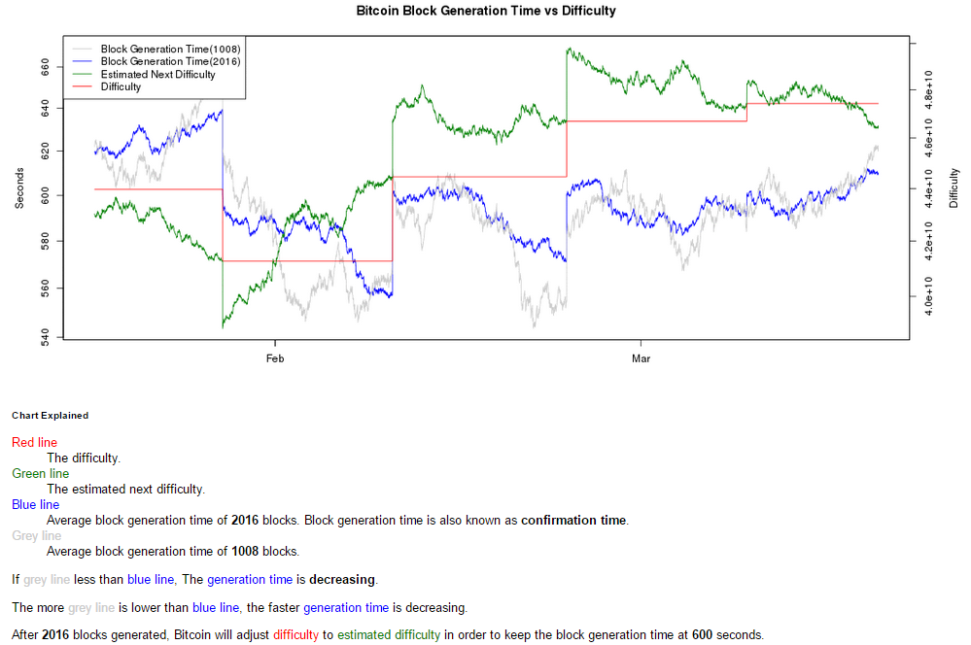
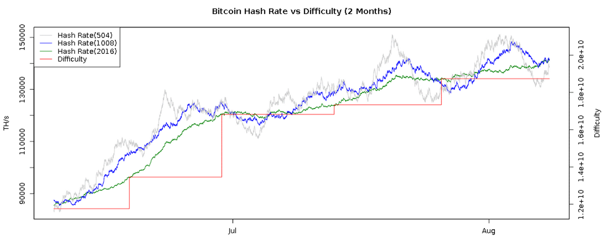

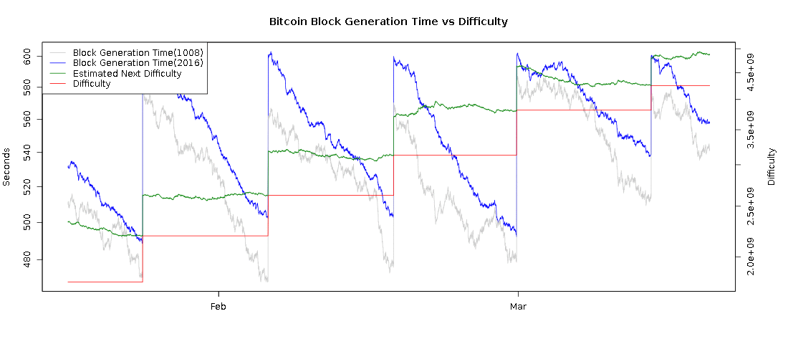
Difficulty over time
catastrophic decline
death spiral
6
Notes:
-why is difficulty a step function?
-average of 504, 1008, and 2016 blocks
-why does block generation time go up and then come down?
-more and more miners come online – block generation time goes down
-then boom! Difficulty resets!
-for most of 2013 and 2014, it took about 9 minutes on average to mine a block, and would usually approach 8 minutes near the end of the 2 week mark
-this means there was about a 25% growth in mining every two weeks! 100% within a month! Over 1000% within a year.
-this has slowed down in 2015 – average time is much closer to 10 minutes
Plus – difficulty decreases also happen
-last chart from Spring, 2015
-death spiral – dropping exchange rate makes mining unprofitable for some miners – exodus! Spiral of doom!

Slide 8
Sha-256
general purpose hash function
SHA-2 family: SHA-224,SHA-384,SHA-512
published in 2001
designed by the NSA
remains unbroken cryptographically
weaknesses known
SHA-3 (replacement) under standardization
7

Slide 9
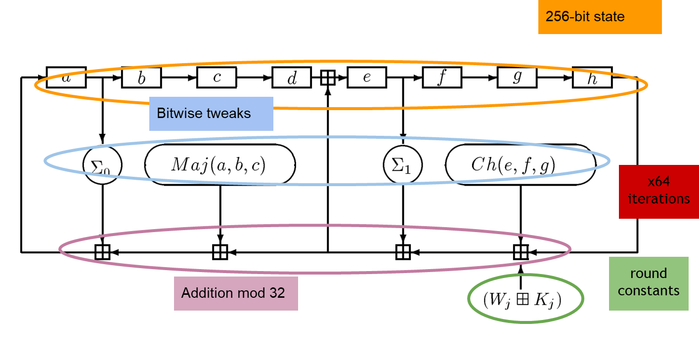
Sha-256
for miners!
manipulate 32 bit words
32 bit modular addition
bitwise logic
8
Notes:
-8 32-bit words (highly optimized for 32 bit hardware)
-small bitwise tweaks applied
-in each round a number of words are taken and added together (mod32)
-entire state is then shifted right
-inspired by design of linear feedback shift registers
-64 rounds (1 round in figure)
-different constants in each round (no two iterations are same!)
Maj and Ch functions - https://crypto.stackexchange.com/questions/5358/what-does-maj-and-ch-mean-in-sha-256-algorithm
Right rotation: https://crypto.stackexchange.com/questions/26215/rationale-for-use-of-right-shift-rather-than-rotate-in-sha-2

Slide 10
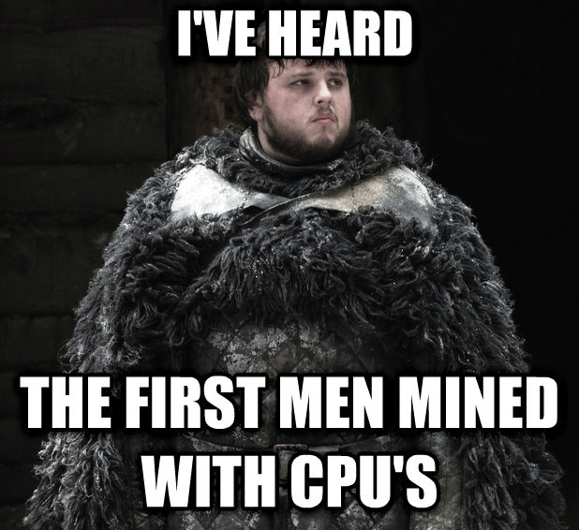
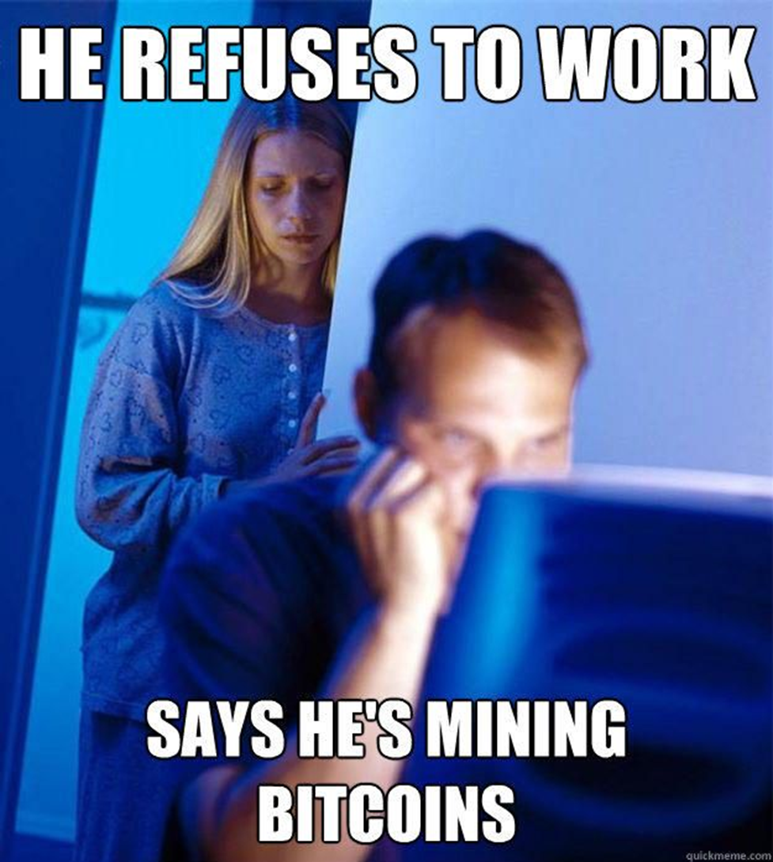
Evolution of mining
Notes:
-whole science to mining

Slide 11
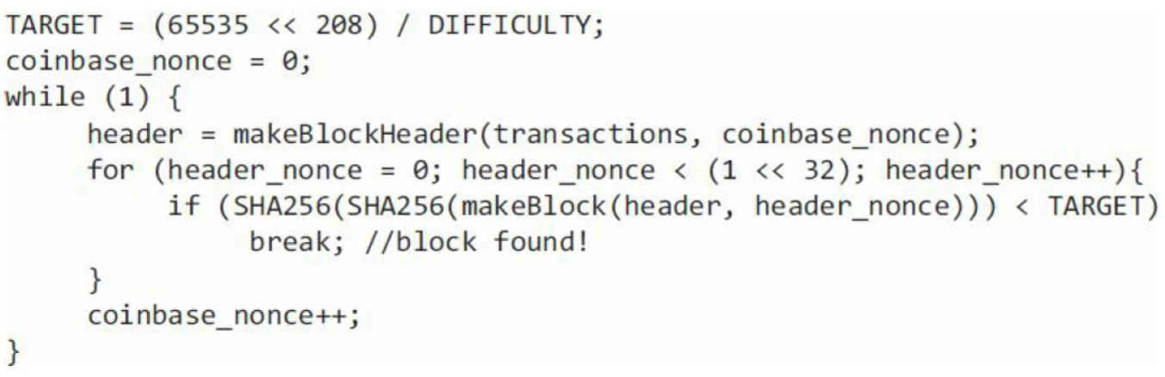
First generation: CPU mining
CPUs!
hash twice!
throughput on a high-end PC = 20 million hashes/s
139,461 years to find a block at 2015 levels! (2⁶⁷)
9
Notes:
-CPU mining pseudocode
-two hashes – quirk!
-code – infinite loop!
-on a high end PC – 20 million hashes per second

Slide 12
Second generation: GPUs
frustration!
GPUs
high parallelism
high throughput
first used for Bitcoin around October 2010
implemented in OpenCL
hacks for specific cards
10
Notes:
-miners got frustrated with CPUs
-parallelism – compute multiple hashes at the same time (with different nonces)!
-2010 – release of OpenCL – general purpose language for doing non-graphics tasks on a GPU – framework for standard parallel computing

Slide 13
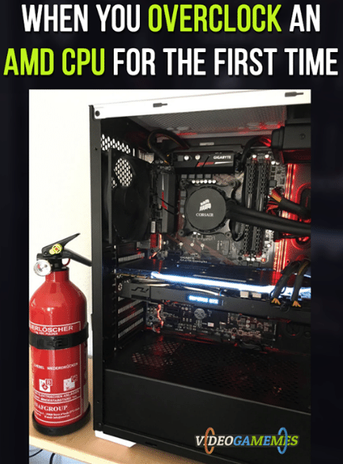
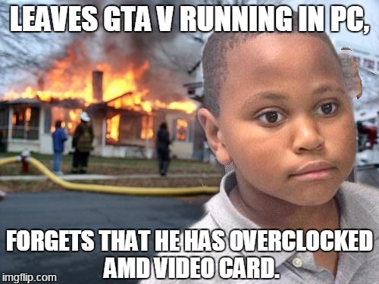
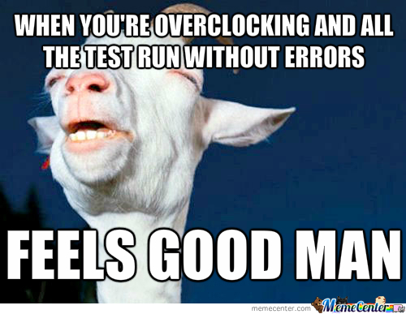
Gpus - advantages
easily available, easy to set up
parallel ALUs
bit-specific instructions
can drive many from 1 CPU
overclock!
speed vs. errors
optimizations vs. profits!
goodput
risk!
11
Notes:
-availability – order online!
-most accessible high-end hardware available to general public!
-overclock – run GPU faster than it is designed for – risk of overheating or malfunction
-e.g. run GPU 50% faster, you get 30% errors in SHA computation -if you get a mistaken result, you can always double check it on your CPU
-speed increase from overclocking > output decrease due to errors – win situation!
-goodput = throughput x success rate = 1.5 x 0.7 = 1.05 i.e. 5% advantage!

Slide 14
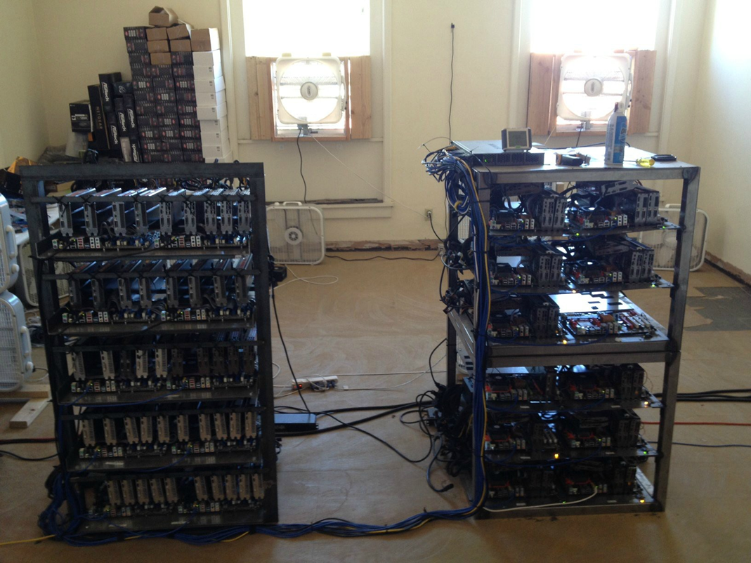
Gpus - advantages
multiple GPUs, single CPU
12
Notes:
-availability – order online!
-most accessible high-end hardware available to general public!
-overclock – run GPU faster than it is designed for – risk of overheating or malfunction
-e.g. run GPU 50% faster, you get 30% errors in SHA computation -if you get a mistaken result, you can always double check it on your CPU
-speed increase from overclocking > output decrease due to errors – win situation!
-full

Slide 15
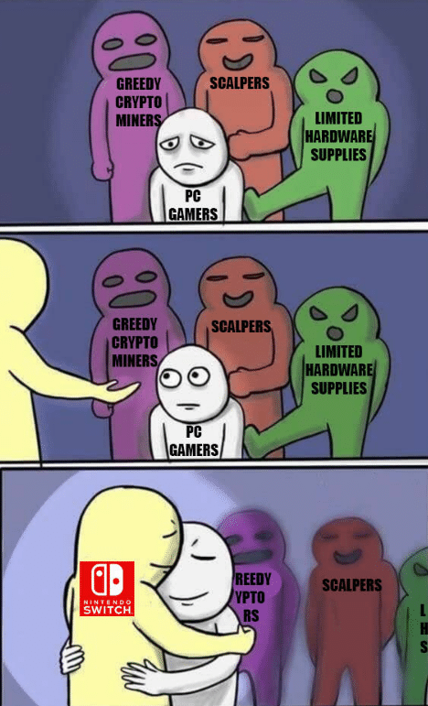
Gpus - disadvantages
superfluous hardware features
thermal characteristics
2011 – market upset
electricity
build-your-own-rig
200 million hashes/s
100 GPUS?
demise
early-stage altcoins
12
Notes:
-GPUs have specific video processing hardware capabilities too which are irrelevant for mining and therefore wasted e.g. large number of floating point units
-GPUs overheat if you stack them – not designed to run side by side – designed to be in a single box with a computer doing graphics processing
-As we reported back in June of last year, this shortage in graphics cards is being indirectly caused by the skyrocketing value cryptocurrencies. The same cards that make PC games look amazing can also “mine” (or generate) digital coins like Ethereum and Zcash, so cryptocurrency miners are buying them in bulk and leaving few behind for gamers. Graphics cards manufacturer Nvidia is apparently well aware of this, and recently recommended that retailers prioritize gamers over miners.
-Böhles was responding to the practice of retailers limiting customers to only one or two GPU purchases at a time.
-Nintendo Switch – gamers recommended to go for consoles!
-200 million hashes/s – order of magnitude better than CPUs
-even with 100 GPUs it would take 100s of years to find blocks at 2015 difficulty level

Slide 16
Third generation: FPGAs
field programmable gate array
first used for Bitcoin ca. June 2011
implemented in Verilog
customized hardware approach
better than GPUs, especially with bit-fiddling
easier cooling
optimized use of hardware
multiple FPGAs, one CPU
better array configurations
1 gigahash/s speeds
12
Notes:
-customized hardware approach – FPGAs approximate customized hardware and enable tweaking in the field
-you can theoretically use all the transistors on the card for mining
-big performance gain over CPUs and GPUs but still with 100 boards, it would take 100 years or so to find a block at 2015 difficulty levels

Slide 17
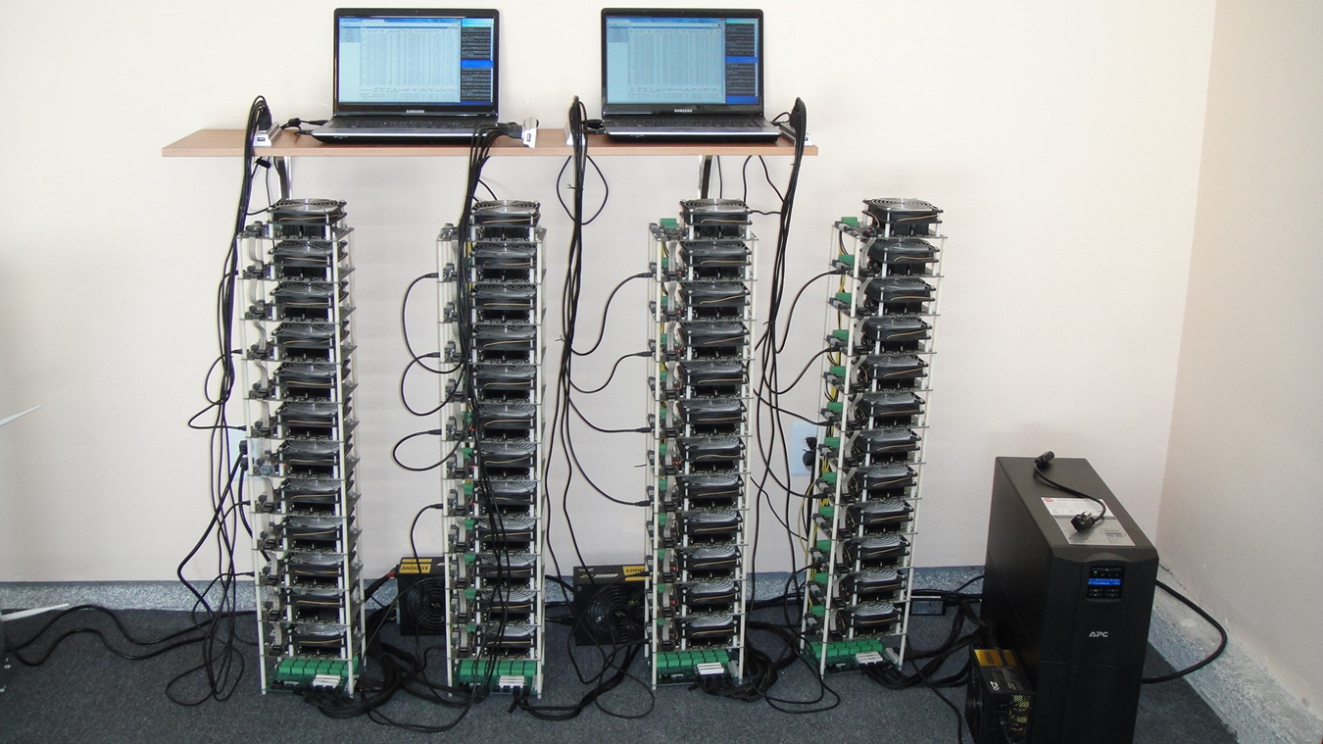
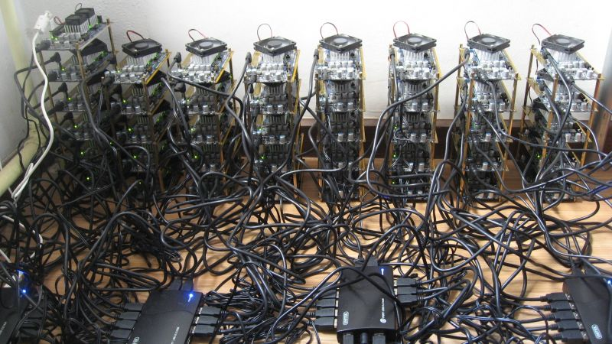
FPGA rigs
12

Slide 18
FPGAs - disadvantages
availability
higher power draw than GPUs
overclocked – frequent malfunctions, errors
poor optimization of 32-bit additions
fewer hobbyists with sufficient expertise
more expensive than GPUs
marginal performance/cost advantage over GPUs
shorter lifecycle
12
Notes:
-less accessible than GPUs
-32 bit addition is critical to SHA256
-GPU mining dominated for a year or so, FPGAs only lasted a few few months before ASICS came along

Slide 19
Gpus - advantages
easily available, easy to set up
parallel ALUs
bit-specific instructions
can drive many from 1 CPU
overclock!
speed vs. errors
optimizations vs. profits!
risk!
13
Notes:
-availability – order online!
-most accessible high-end hardware available to general public!
-overclock – run GPU faster than it is designed for – risk of overheating or malfunction
-e.g. run GPU 50% faster, you get 30% errors in SHA computation -if you get a mistaken result, you can always double check it on your CPU
-speed increase from overclocking > output decrease due to errors – win situation!
-full

Slide 20

ASICS
today!
customized, sole purpose
lead time
fastest turnaround
bugs
Initially short lifetime
6 weeks cost recovery
shipping speed!
14
Notes:
-ASICs typically have long lead time
-these ASICs have the fastest turnaround time in the history of integrated circuits
-first few generations had lots of bugs due to turnaround time
-boards can become obsolete by the time they reach the customer

Slide 21
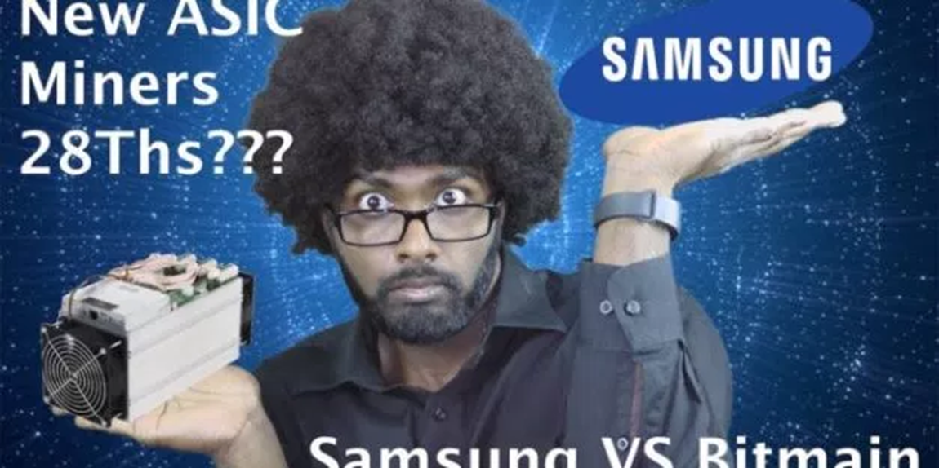
ASICS
mining lifetime vs. hash power stabilization
small miner disadvantage
exchange rate factor
investment: bitcoins vs. mining equipment?
politics
15
Notes:
-technically small miner would lost money due to mining difficulty increase – but exchange rate rise compensated
-for many miners, they would have made more money if they had invested in Bitcoin rather than in mining equipment
-Bitmain – equipment + 29% share in pool

Slide 22
Homework
Chap 5: Bitcoin mining Bitcoin and Cryptocurrency Technologies: A Comprehensive Introduction
Hashcash on Wikipedia (link)
Difficulty charts (link)
The evolution of Bitcoin hardware (link)
Nvidia says ‘Gamers come first’ (link)
Digital drills (link)
Samsung enters the market (link)
Samsung – update 2021 (link)
Bitmain – pricing + inventory updates (link)
16

Slide 23
Further reading
Bitcoin obituaries (link)
Visualizing huge odds (link)
17

